Slide 1
Geovisual Exploration/Analytics

Slide 2
Visualization
is any technique for creating images, diagrams, or animations to communicate a message.
scientific visualization is the use of interactive, sensory representations, typically visual, of abstract data to reinforce cognition, hypothesis building, and reasoning.
Data visualization is a related subcategory of visualization dealing with statistical graphics and geographic or spatial data (as in thematic cartography) that is abstracted in schematic form.
Maps are also form of information visualization.

Slide 3
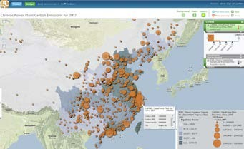
Geovisualization
Integrating approaches from disciplines including cartography with those from scientific visualization, image analysis, information visualization, exploratory data analysis and GIS Science.

Slide 4
Geovisualization and Maps
Maps are used to stimulate (visual) thinking about geospatial patterns, relationships and trends
View geospatial data sets in a number of alternative ways
Multiple representations with out constraints (traditions)
Supporting knowledge construction
Traditional, static maps have a limited exploratory capability; the graphical representations are inextricably linked to the geographical information beneath.
GIS and geovisualization allow for more interactive maps; including the ability to explore different layers of the map, to zoom in or out, and to change the visual appearance of the map, usually on a computer display.

Slide 5
Brushing
consists of the interactive selection of a subset of the displayed data by either dragging the mouse over the data of interest or using a bounding shape to isolate this subset.
Linking refers to the process in which user interactions in one display of a multi-display system are applied to some or all other displays.
Together, linked brushing is one of the most powerful interactive tools for doing exploratory data analysis using visualization.

Slide 6
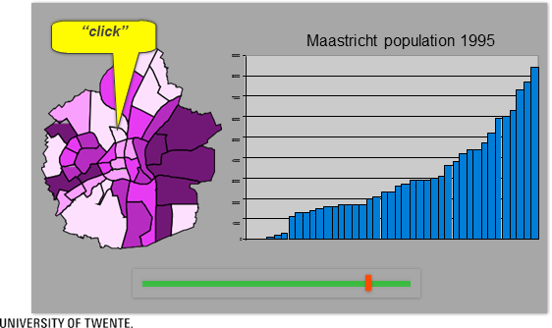
Geographic Brushing

Slide 7
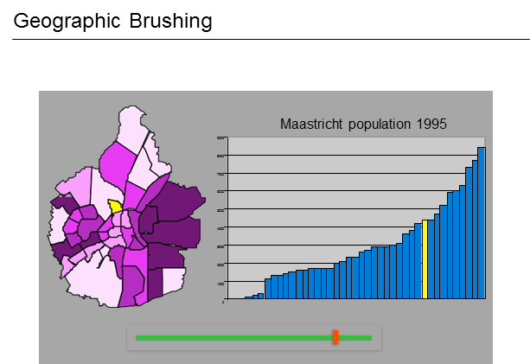

Slide 8
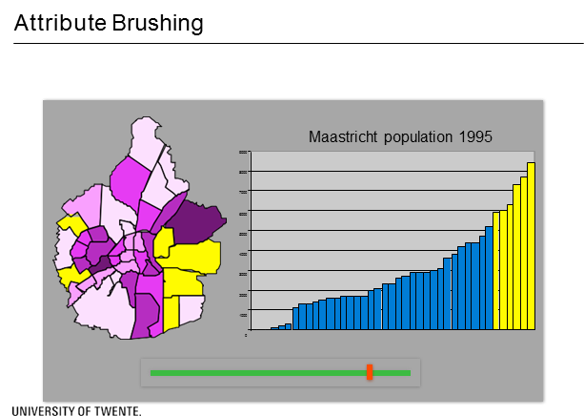

Slide 9
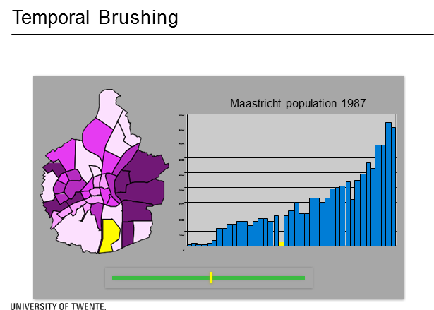

Slide 10
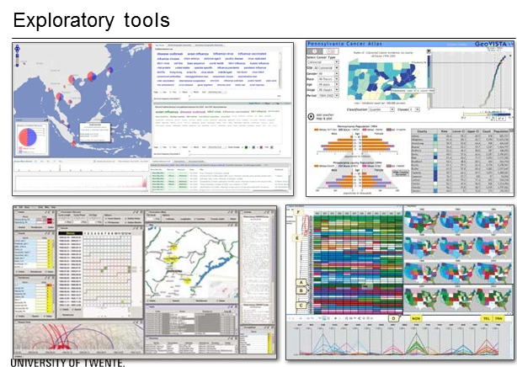

Slide 11
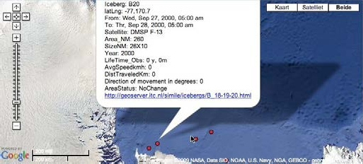
Visualization Strategies:
Overview first
Zoom / Filter
Details on Demand

Slide 12
Required functionality:
Identify
Select
Compare
Zoom/Pan
Query etc…

